Slide 1
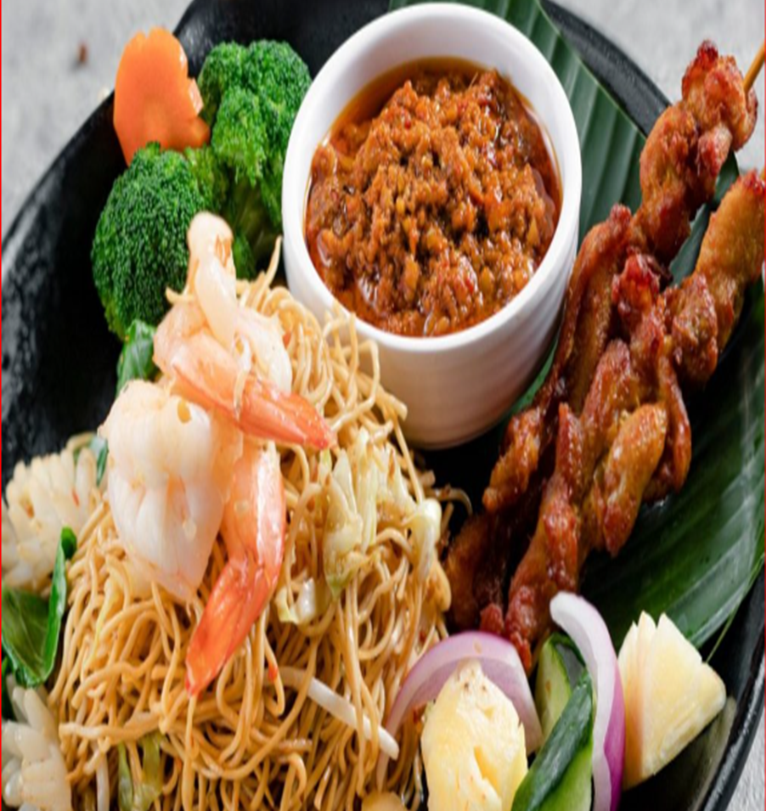


Marketing Presentation for Thai To Go
Leong Joo Seng – 617H
http://thaitogo.sg
‹#›

Slide 2
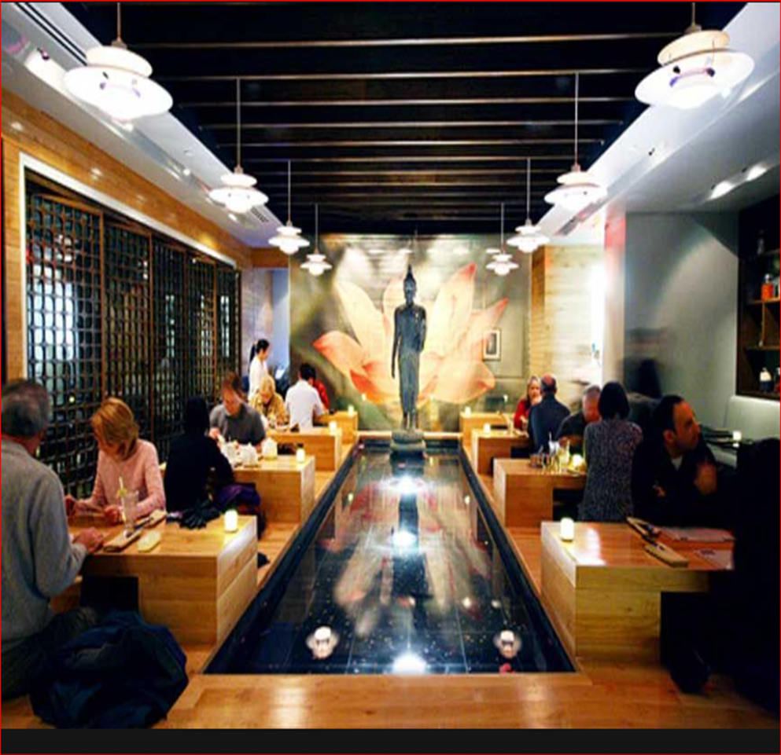
Company Background for
Thai To Go
http://www.thaitogo.sg

Slide 3




Company Background
Thai To Go is a halal thai restaurant on Changi road near Eunos MRT
They offer
In operation for 10 years already
The company website address is: http://thaitogo.sg
Order & Pickup
Island wide delivery
Dining In
Mini catering for min 10 pax (No license to do full catering)

Slide 4



Core Services & Persona
#1 - In-Restaurant Dines
#2 - Online Delivery
#3 - In-Restaurant Catering
Residents and office workers nearby coming for lunch and dinner
Residents and office workers nearby coming for lunch and dinner
Customers interested in hosting a 20-40 pax event at the restaurant

Slide 5
Current Lead Generation
All leads are currently generated by
Word of mouth
Food Panda for delivery leads
https://www.foodpanda.sg/restaurant/w8kc/thai-to-go-changi-road
Leads Catering
https://www.foodline.sg/catering/Thaitogo/

Slide 6


Unique Value Proposition
"Homely yet Affordable cuisine" Only Halal Certified Thai restaurant around Eunos MRT
Recipes & Taste catered towards locals
Mini catering can be booked next day instead of 3-4 days in advance
Very flexible menu depending on what the customer wants (bento box, lunchset etc)
40 seater capability restaurant that can host parties, gatherings, parties by just ordering at least 20 pax
Can cater to individual taste buds - more spicy, less salty, etc
Has Fusion Thai, Malay & Western Menu

Slide 7
Problem Statement
“Business was good before covid-19 but dropped since then as businesses have more competitions.
"I want to increase orders, preferably deliveries & catering"
"Open to suggestion for special offers to get people’s attention"

Slide 8

Marketing Plan

Slide 9





Executive Summary
BUSINESS OBJECTIVE:
THE MARKETING CAMPAIGN FOR THAI TO GO AIMS TO INCREASE ONLINE DELIVERY ORDERS BY 30% AND CATERING ORDERS BY 20% WITHIN THE NEXT 6 MONTHS TO DRIVE LONG-TERM CUSTOMER LOYALTY AND REPEAT BUSINESS.
TARGET MARKET:
YOUNG PROFESSIONALS AND OFFICE WORKERS NEAR EUNOS MRT STATION, SEEKING CONVENIENT, AFFORDABLE AND HALAL-CERTIFIED THAI CUISINE FOR LUNCH, DINNER AND EVENTS.
MARKET NEED:
THE PERSONA DESIRES A HALAL-CERTIFIED RESTAURANT THAT OFFERS FLEXIBLE, AFFORDABLE AND CUSTOMIZABLE MENU OPTIONS WITH QUICK NEXT-DAY MINI CATERING SERVICES WHICH THAI TO GO UNIQUELY PROVIDES IN THE EUNOS MRT AREA.
Notes:
These points succinctly capture the essence of the marketing strategy and align with the company's goals and target audience needs.

Slide 10
Executive Summary
Product Overview:
Thai To Go is a halal-certified Thai-styled restaurant that stands out in the Eunos MRT area by offering a unique blend of Thai, Malay, and Western cuisines tailored to local tastes. Our specific selling points include:
Convenient Location: Easily accessible from Eunos MRT, making it a prime spot for nearby residents and office workers.
Affordable Pricing: More budget-friendly compared to other halal Thai restaurant chains like Pattaya Garden and Jai Thai.
Flexibility: Customizable menu options (e.g., bento boxes, lunch sets) and quick next-day mini catering services for events.
Homely Cuisine: Recipes crafted to provide a homely yet affordable dining experience, accommodating individual taste preferences (e.g., spice levels).
Market Strategy:
Which channels, what sort of content do you intend to use to execute marketing to bring them from awareness through consideration to deciding to give you their business
Notes:
By strategically using these channels and creating compelling content, we aim to guide our target market through the awareness, consideration, and decision stages, ultimately increasing our online delivery and catering orders while building a loyal customer base.

Slide 11
Executive Summary
Market Strategy:
Channels and Content:
Social Media: Leverage Instagram and Facebook to share engaging content such as high-quality images and videos of popular dishes, behind-the-scenes footage, and customer testimonials. Utilize targeted ads to reach potential customers and drive traffic to our website.
Food Delivery Apps: Enhance our presence on platforms like Food Panda to attract delivery orders. Offer exclusive deals and discounts to first-time users.
Google Ads: Implement search and display campaigns to capture intent-driven traffic searching for halal Thai food and catering services near Eunos.
SEO and Content Marketing: Create SEO-optimized blog articles and lead magnets (e.g., "Ultimate Guide to Halal Thai Food in Singapore") to attract organic traffic and build authority in the niche.an email newsletter to keep subscribers informed about special offers, new menu items, and upcoming events.
Website Optimization: Ensure our website is conversion-focused with clear calls to action, interactive menus, and special offers prominently displayed.
Notes:
By strategically using these channels and creating compelling content, we aim to guide our target market through the awareness, consideration, and decision stages, ultimately increasing our online delivery and catering orders while building a loyal customer base.

Slide 12
Executive Summary
Market Strategy:
Marketing Funnel Stages:
Awareness: Generate awareness through social media ads, engaging posts, and SEO-optimized content to attract new customers.
Consideration: Provide detailed information about our unique value propositions, customer reviews, and special promotions to persuade potential customers.
Decision: Drive conversions with clear and compelling calls to action on our website, special offers for first-time customers, and easy online ordering options.
Notes:
By strategically using these channels and creating compelling content, we aim to guide our target market through the awareness, consideration, and decision stages, ultimately increasing our online delivery and catering orders while building a loyal customer base.

Slide 13
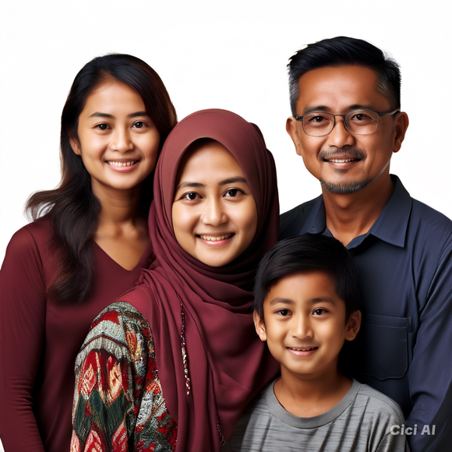
Persona / Ideal Customer
Demographic Information
Name | Azim Ahmad, Aishah, Amani & Adam
Age | 45, Father, 42, Mother, 18, Daughter & 15, Son
Occupation | DIGITAL CREATIVE DIRECTOR
Education Level | Azim and Aishah likely have at least a high school education, with Amani attending university. Adam is in high school.
Location | EUNOS, SINGAPORE
Single or Married? Any kids? | Married couple with 2 children
Income Level | Upper-middle class. Azim works, Aishah has a stable job, suggesting they can afford regular food delivery. Total income about S$140,880 PER YEAR
Notes | 4 members, a typical family size

Slide 14
Persona / Ideal Customer
Psychographic Information
Life stage | The Ahmads are in a mid-life stage, characterized by personal growth and career stability. Azim (45): Potentially nearing career stability, with a focus on family and leisure. Aishah (42): Likely in her peak career years, balancing work and family responsibilities. Amani (18): Transitioning into early adulthood, exploring independence and personal goals. Adam (15): Navigating adolescence, seeking independence and social connections.
Pain Points | Time Constraints: The busy lives of Azim and Aishah likely lead to limited time for cooking and meal preparation. Variety and Health Concerns: Amani's interest in healthy eating and Azim's desire for comfort food create a challenge in finding meals that satisfy everyone's needs. Budget and Value: The family is price-conscious and wants to ensure they're getting good value for their money. Teenage Independence: Adam's desire for independence may lead to conflicts over food choices and mealtimes.
Motivations | Convenience and Efficiency: The Ahmads value a hassle-free way to get meals on the table, especially during busy weeknights. Family Harmony: Finding meals that everyone enjoys promotes a sense of togetherness and family satisfaction. Health and Well-being: Amani's focus on healthy eating influences the family's food choices. Exploration and New Experiences: Aishah's interest in trying new cuisines adds excitement and variety to their meals.
Challenges | Balancing Dietary Needs: Finding halal food that caters to both healthy and comfort food preferences can be challenging. Managing Teenage Food Choices: Adam's preferences and potential for unhealthy choices may require careful consideration. Budgeting for Food Delivery: Balancing the convenience of delivery with the cost can be a challenge. Finding Reliable Delivery Services: Ensuring consistent quality and timely delivery is important for the family's busy schedule.
Core Values & Beliefs | Family: The Ahmads prioritize family time and shared meals as a way to bond and connect. Religion: Halal food is a non-negotiable requirement, reflecting their Muslim faith. Health and Well-being: The family values healthy eating and recognizes its importance for overall well-being. Value for Money: They prioritize getting good value for their money and are likely to seek deals and promotions.

Slide 15
Persona / Ideal Customer
Service Needs & Preferences
Online Behaviour | Actively uses platforms like Facebook and Instagram to follow food trends and discover new restaurants.
Preferred Communication Channels . | • Social Media (Instagram, Facebook) • Food Delivery Apps (Food Panda) • Search Engines (Google) • Email Newsletters
Service Expectations | •Find a convenient and tasty dining option near her office •Arrange catering for office meetings and personal gatherings •Discover new and exciting food options that fit her dietary needs
Price Sensitivity | Willing to pay for good quality food at an affortable price

Slide 16
Persona / Ideal Customer
Decision Making Process
Information Sources | ISocial Media: Facebook, Instagram, and WhatsApp for recommendations and promotions. Food Delivery Apps: Food Panda, GrabFood for browsing menus and placing orders Online Reviews: Google Reviews, Yelp for customer feedback. Food Blogs and Vlogs: Popular local food bloggers and YouTube vloggers for reviews. Family and Friends: Recommendations through personal interactions and social media.
Influencers | Food Bloggers: Local food bloggers with a large following. Social Media Influencers: Instagram influencers specializing in food and lifestyle. YouTube Vloggers: Popular vloggers reviewing restaurants and food delivery services.
Barriers to entry | Health Concerns: Uncertainty about the nutritional value and halal certification. Cost: Perception of high prices for dining out or ordering in. Time Constraints: Busy schedule limiting the ability to dine in or wait for delivery. Trust Issues: Skepticism about online reviews and unfamiliar restaurants.
Decision Triggers | Promotions and Discounts: Special offers and discounts prompt immediate action. Positive Reviews: High ratings and positive customer feedback encourage trying new places. Recommendations: Trusted recommendations from family, friends, or influencers. Convenience: Easy online ordering and quick delivery options drive decisions.

Slide 17
SWOT Analysis of Thai To Go
Strengths - What other business cannot compete with Halal Certification: Attracts Muslim customers as the only halal-certified Thai restaurant near Eunos MRT. Diverse Menu: Offers unique fusion of Thai, Malay, and Western cuisines appealing to a wide range of tastes | Weaknesses - Why you are losing customers to others businesses Limited Marketing Channels: Relies on word of mouth, Food Panda, and Foodline, limiting reach and visibility POST-COVID Recovery: Experienced a drop in orders due to COVID-19, needing strategies to regain sales and customer trust for lunch crowd due to WFM implementation.
Opportunities - Areas of the business that can be easily done better to improve business. Digital Marketing Expansion: Use social media, SEO, and online ads to increase brand awareness and attract more customers. Special Offers and Promotions: Introduce discounts and loyalty programs to entice new customers and retain existing ones. | Threats - External challenges that could hinder achieving objectives. Competition: Competes with other Thai and halal eateries, giving customers multiple options. Economic Uncertainty: Global Economic fluctuations and potential crises can impact customers spending and business stability.

Slide 18
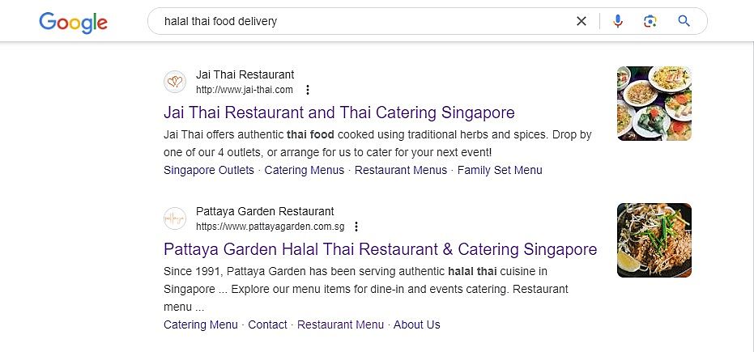
Competitive Analysis - Website

Slide 19
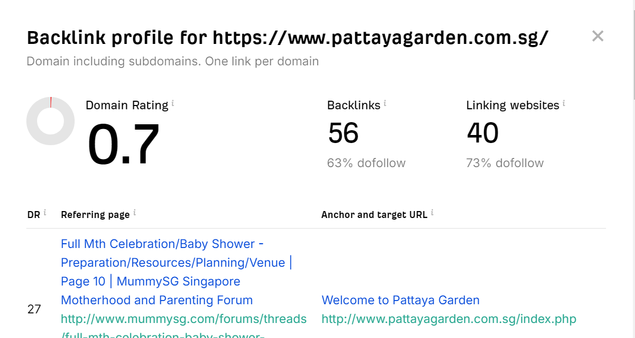
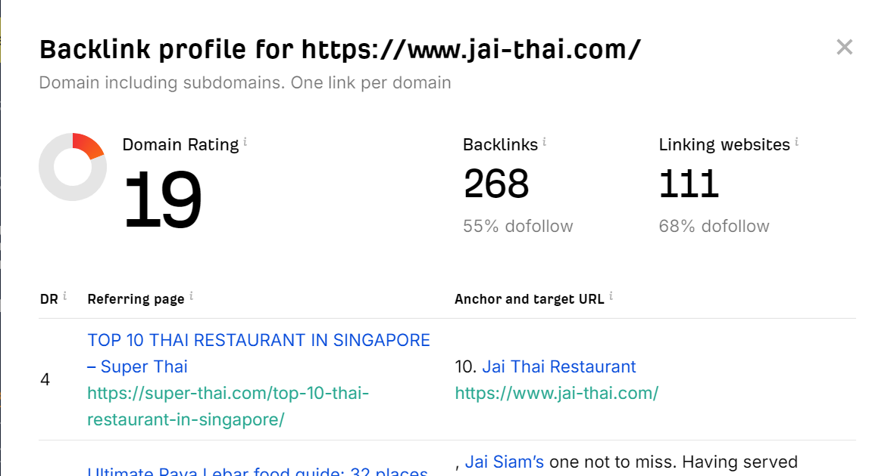
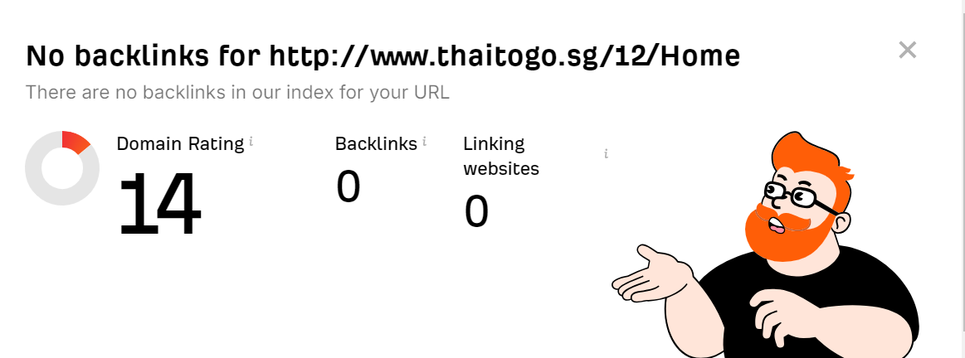
Competitive Analysis - Website

Slide 20
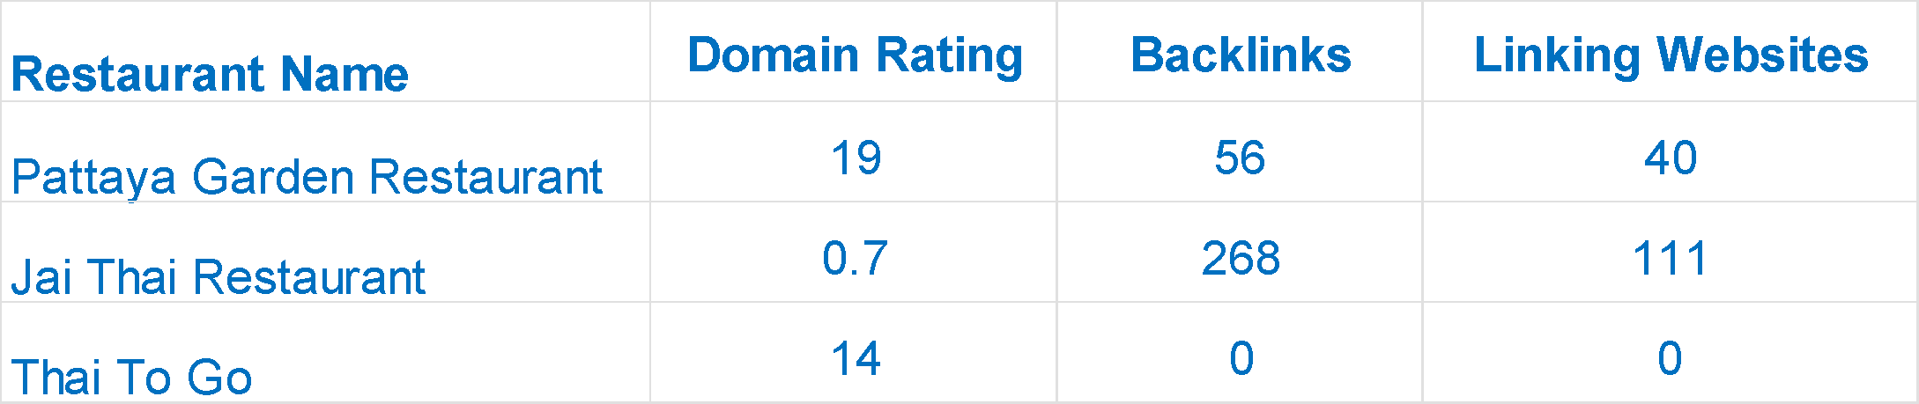
Competitive Analysis - Website

Slide 21
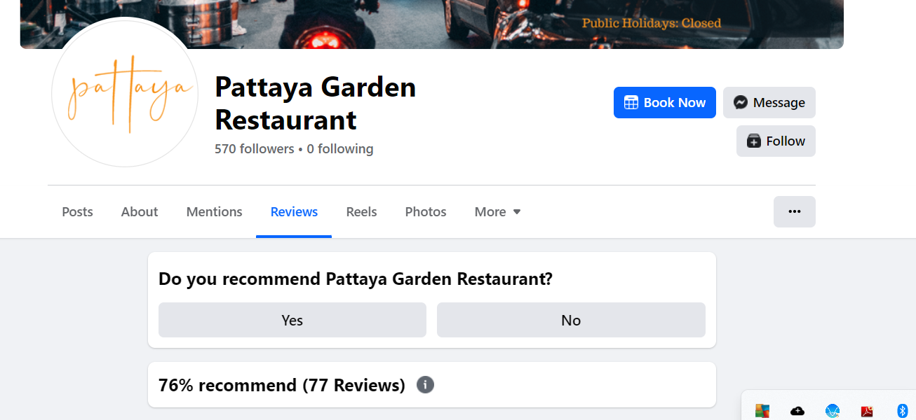
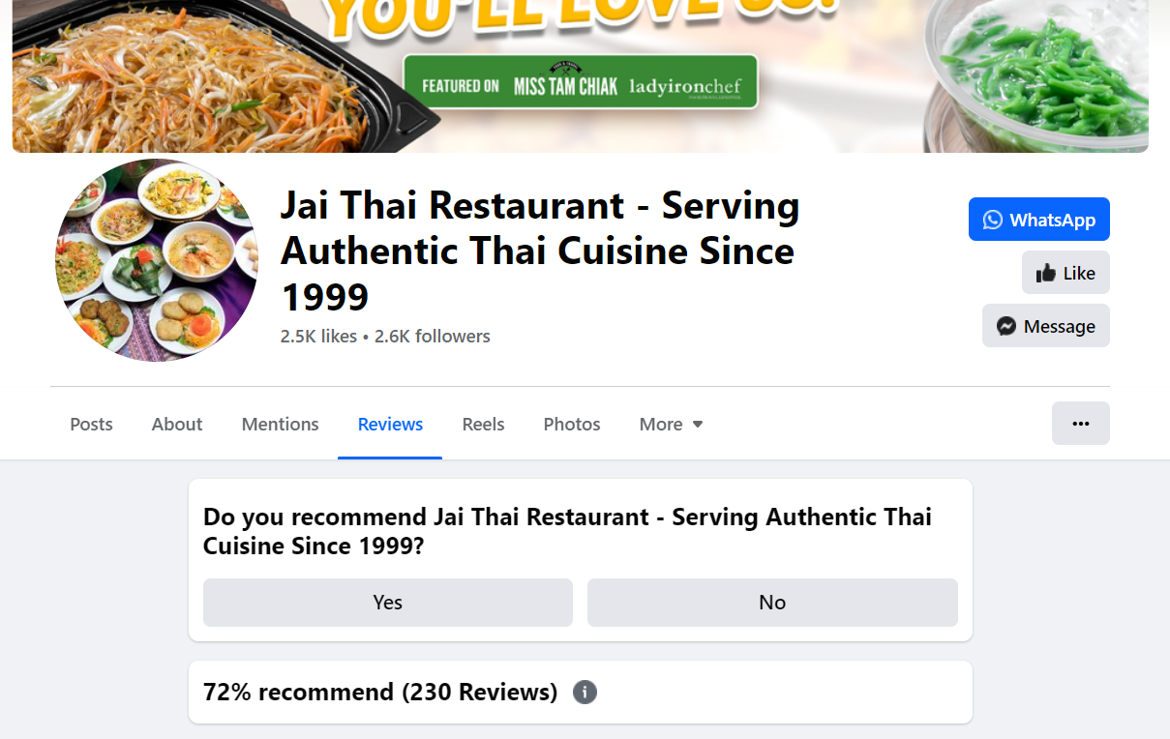
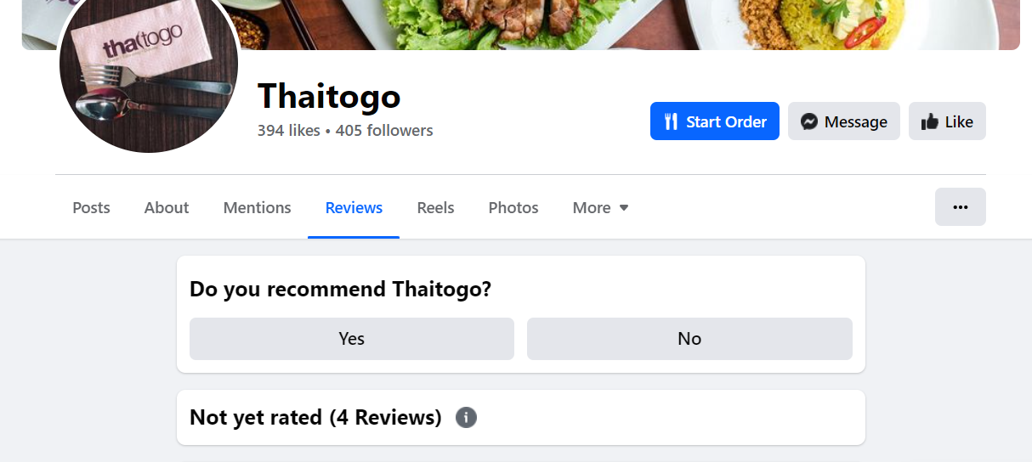
Competitive Analysis - Facebook

Slide 22
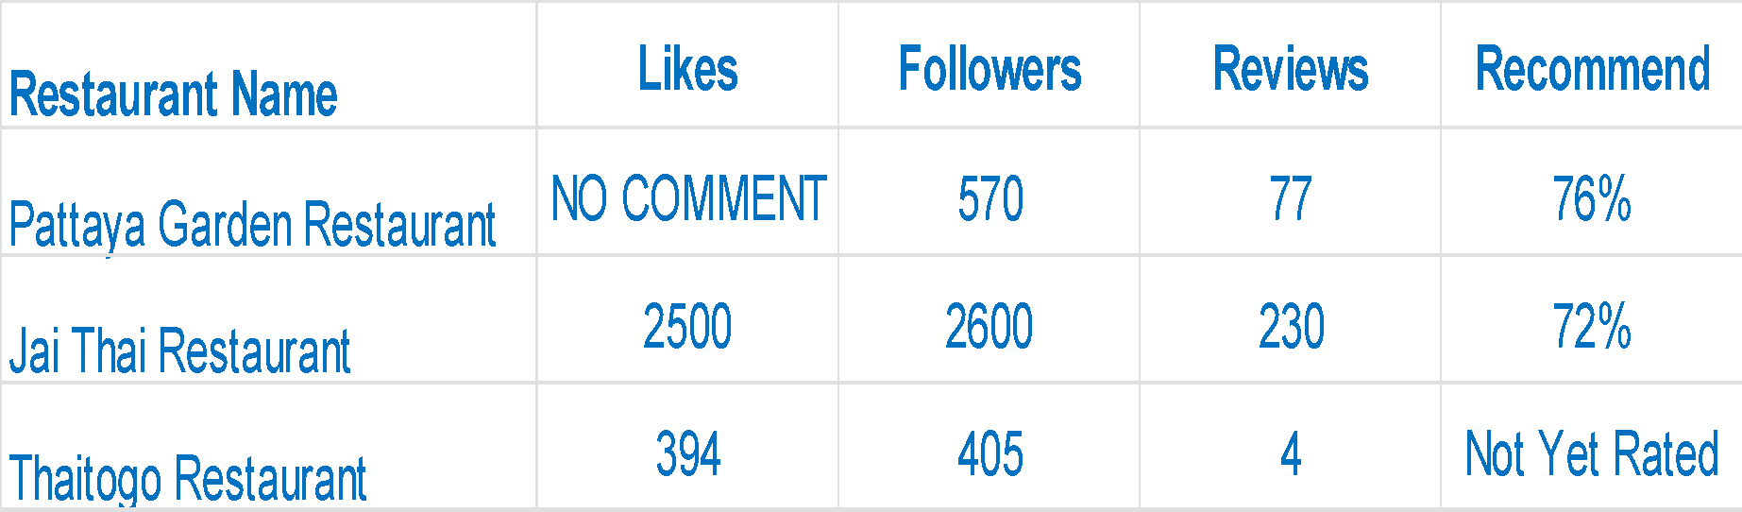
Competitive Analysis - Facebook

Slide 23
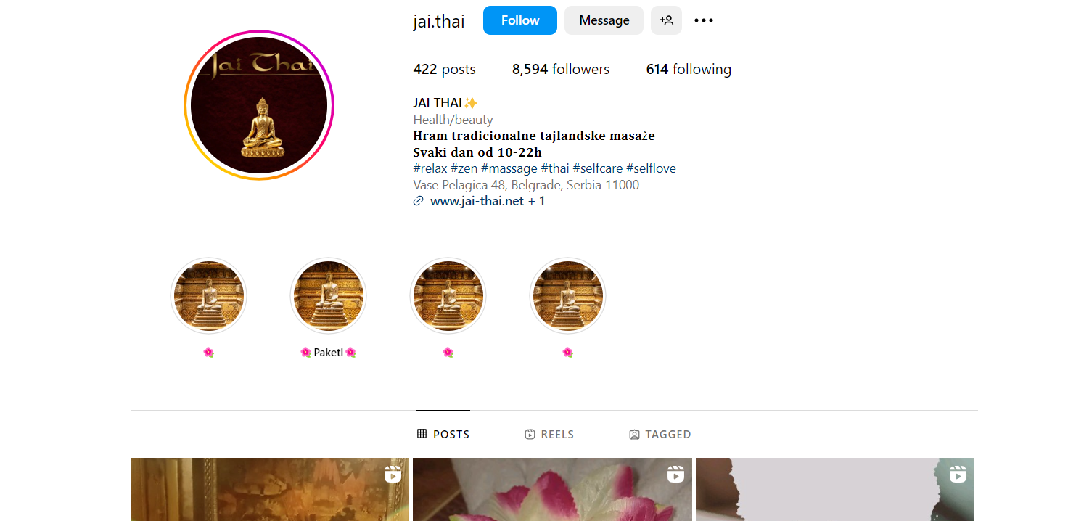
Competitive Analysis - Instagram

Slide 24
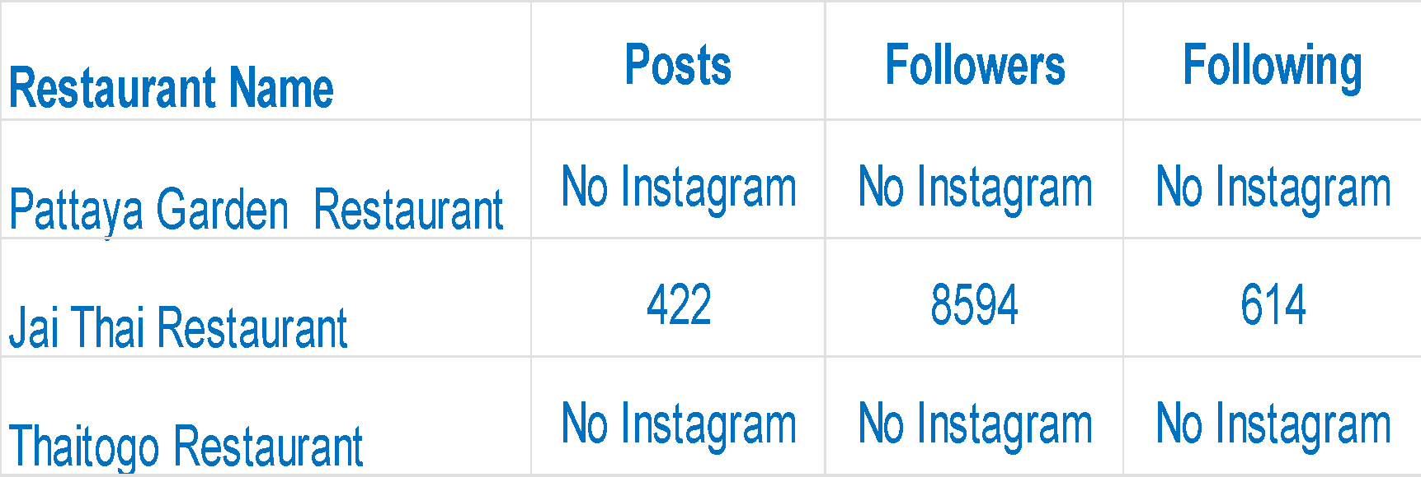
Competitive Analysis - Instagram

Slide 25
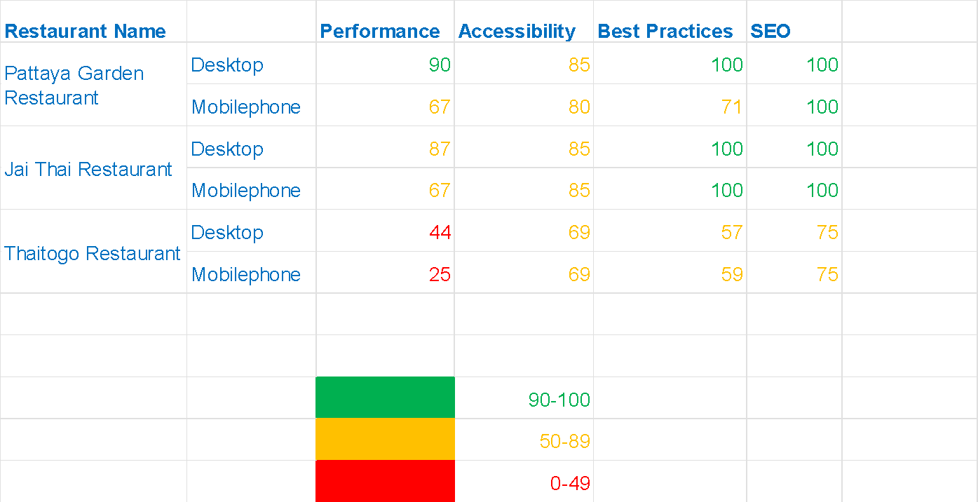
Competitive Analysis - Optimizing Website

Slide 26

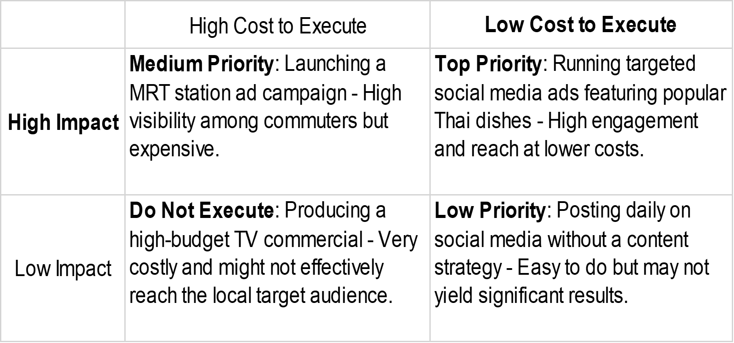
‹#›

Slide 27
Customer Journey (Content)
Customer Lifecycle Stage | Digital Marketing Channels | Content Ideas (Copywritten titles)
Awareness | SMM SMM Ads SEO SEM | +“Discover Authenic Thai Cuisine at Thai To Go” +“Experience Thailand’s Flavors Right Here in Singapore” +“Why Thai To Go is a Must Try for Thai Food Lovers"
Consideration | Landing page Email Remarketing Shop Visit | +“Top 10 Must Try Dishes at ThaI To Go” +”What Our Customers Are Saying About Thai To Go +”Special Offer: 20% off Your First Visit to Thai To Go.
Decision | Online Purchase Phone Call WhatsApp | +"Order online and get free delivery on your first purchase!" +"Call or WhatsApp us to place your order and enjoy a hassle-free dining experience!"

Slide 28
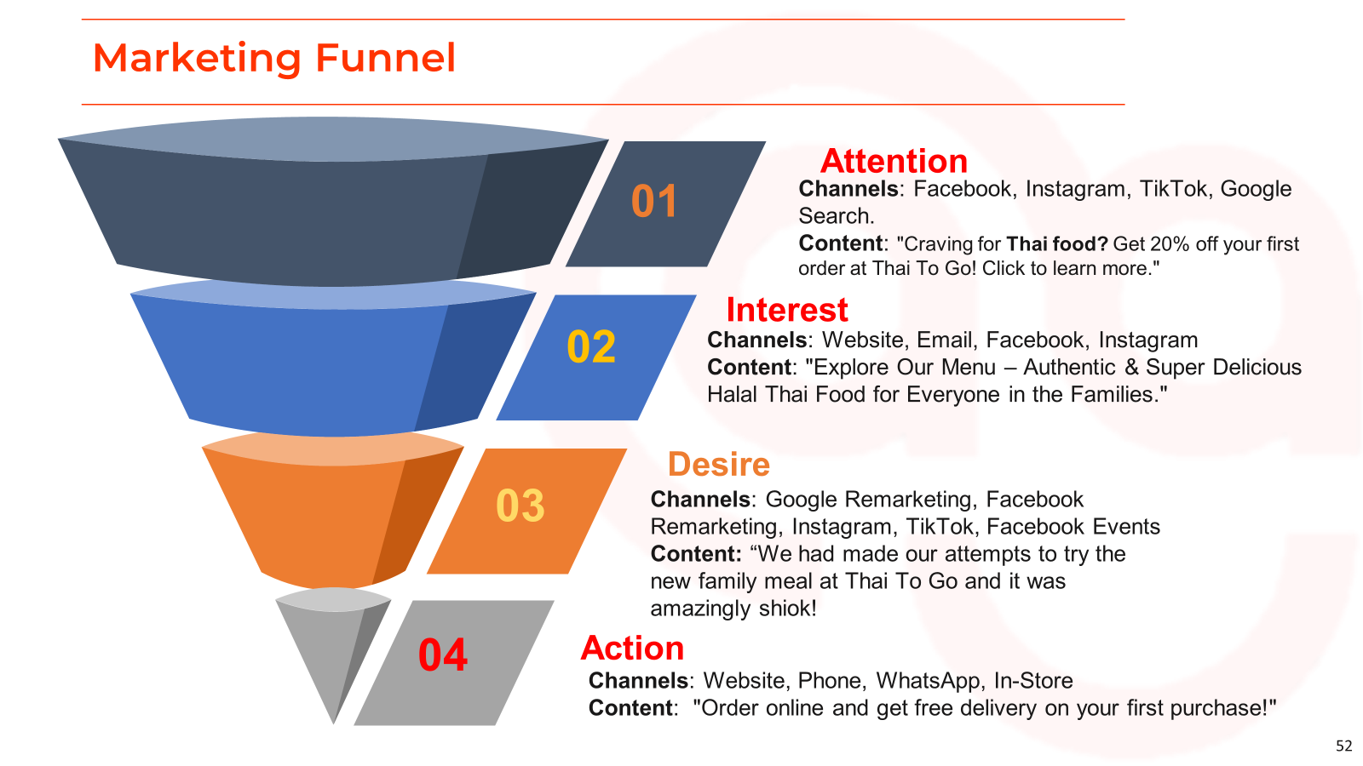

Slide 29

Channel | Metric | KPI | Duration | Notes (if any)
Landing Page | Conversion Rate | +10% | in 3 months time | Increase the conversion rate of the landing page by optimizing content and improving the call-to-action (CTA) within 3 months.
Website | Online Orders | +20% | in 3 months times | Enhance user experience to boost online orders by 20% within 3 months through improved navigation and targeted promotions.
Social Media (Facebook) | Improve post engagement rate | +30% | in 6 months time | Grow Facebook engagement and reach by 30% in 6 months through a combination of organic posts and targeted ads.
Instagram | To Grow Followers | +30% | in 6 months time | Boost Instagram follower count by 30% and increase story views by 30% within 6 months using high-quality visuals and interactive content.

Slide 30
Marketing Execution

Slide 31
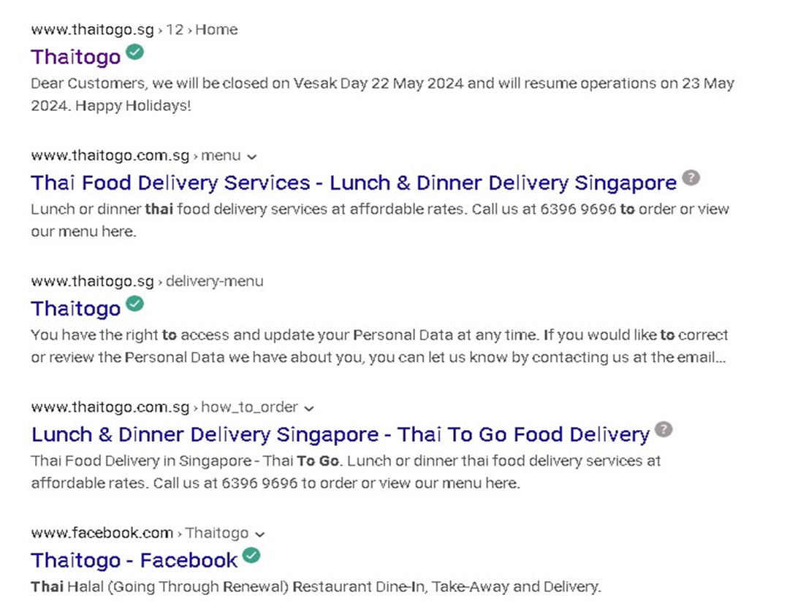
SEM - Google Search Ads

Slide 32
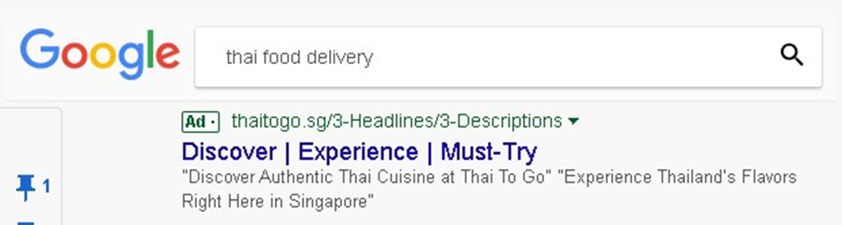
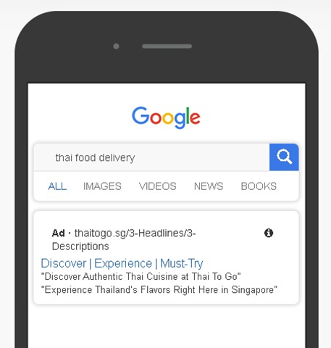
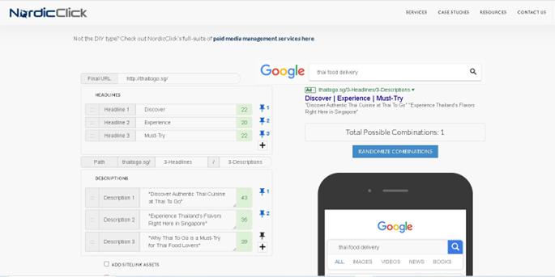
SEM - Google Search Ads (Ad Mock-ups)

Slide 33
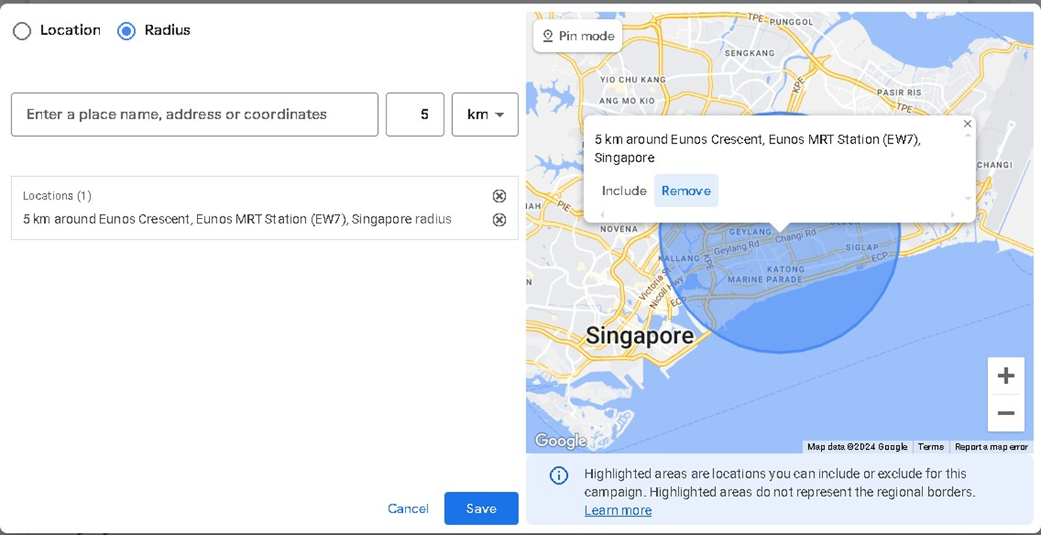
SEM - Google Search Ads (Target Audience)
Simulate your targeted audience segment
Here is how you access it on google ads here

Slide 34
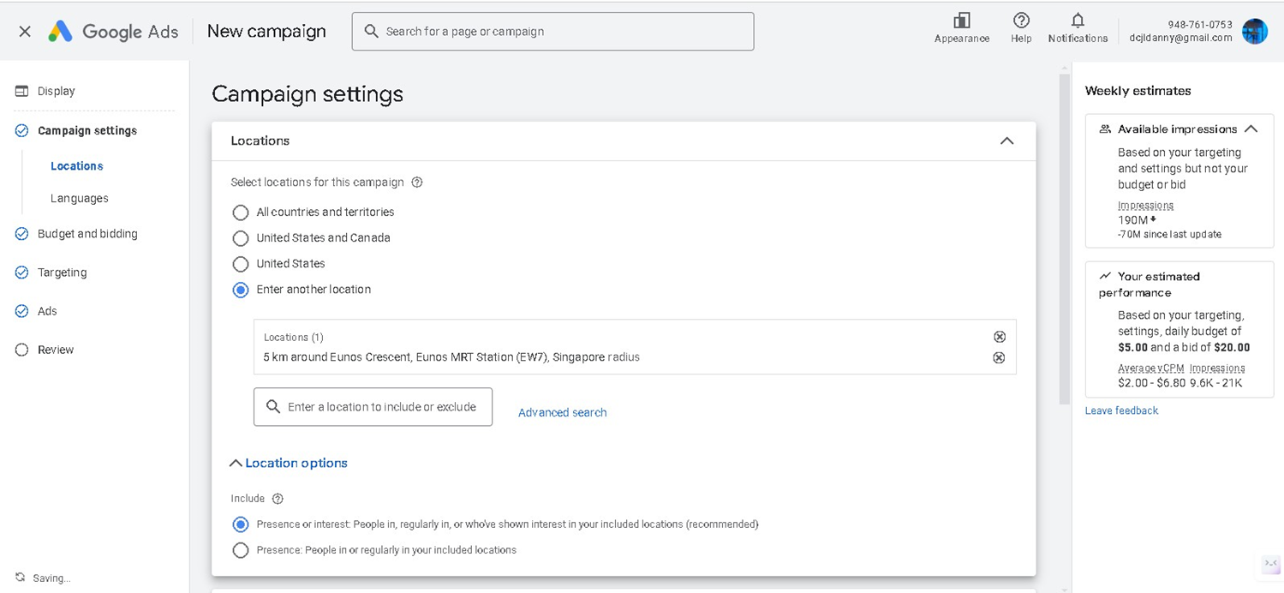

SEM - Google Search Ads (Target Audience)
Simulate your targeted audience segment
Here is how you access it on google ads here

Slide 35
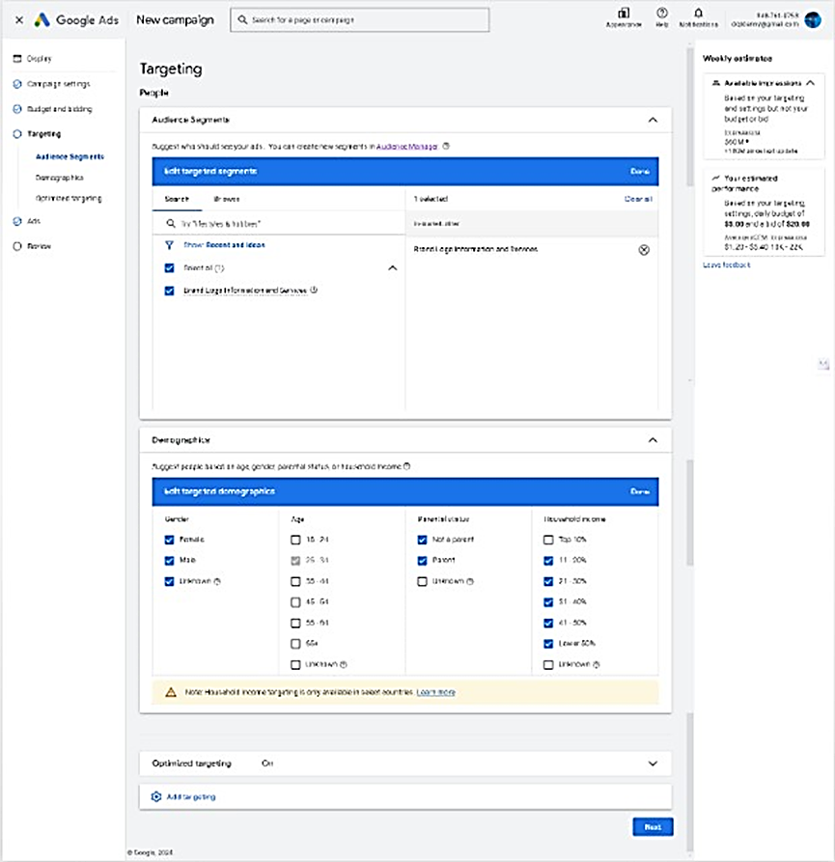
SEM - Google Search Ads (Target Audience)
Simulate your targeted audience segment
Here is how you access it on google ads here

Slide 36
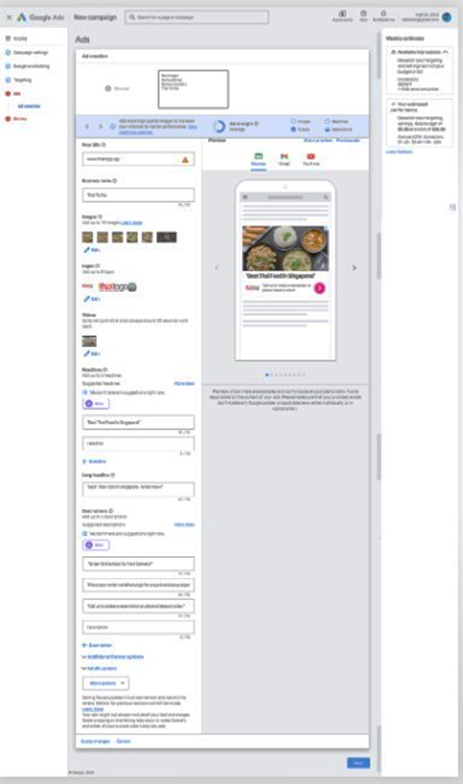
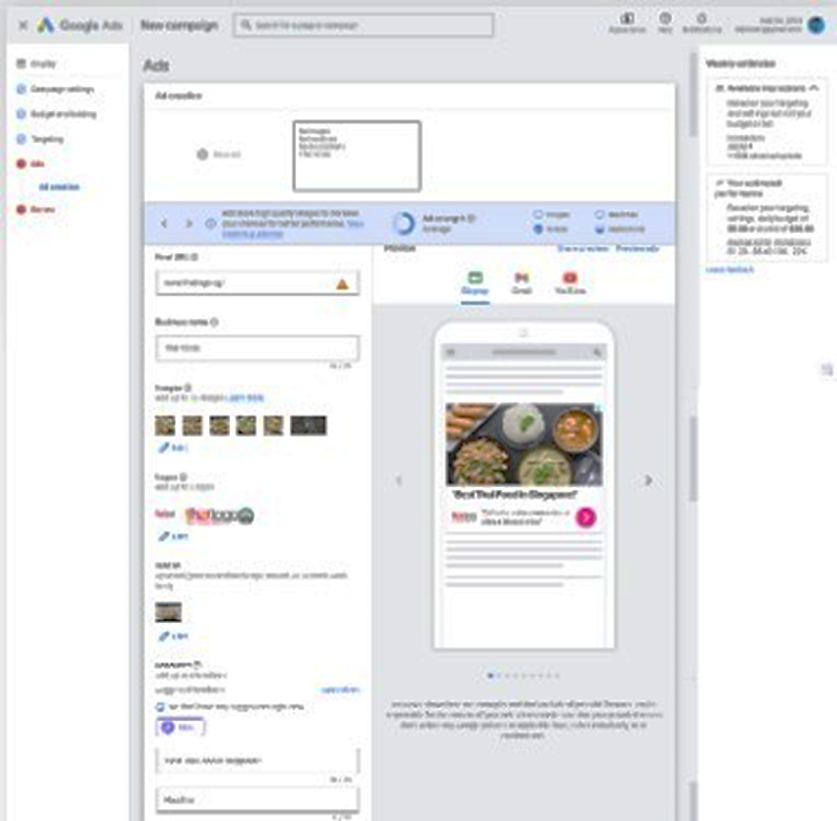
SEM - Google Search Ads (Target Audience)

Slide 37
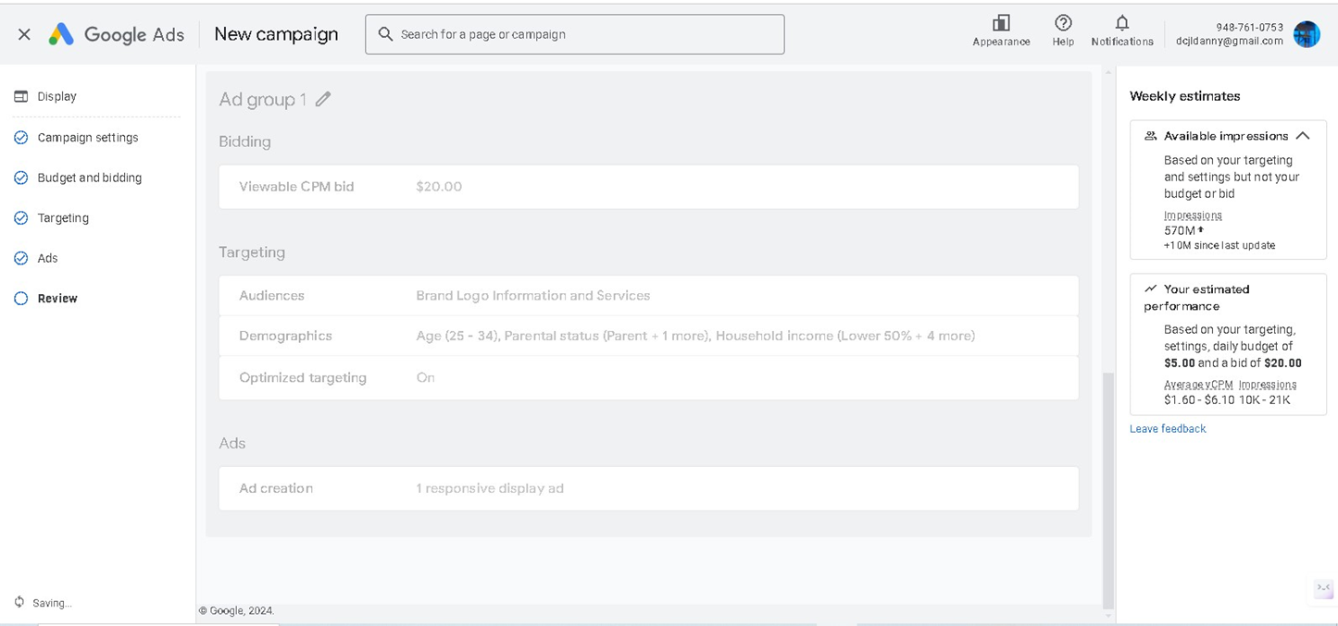
SEM - Google Search Ads (Target Audience)

Slide 38
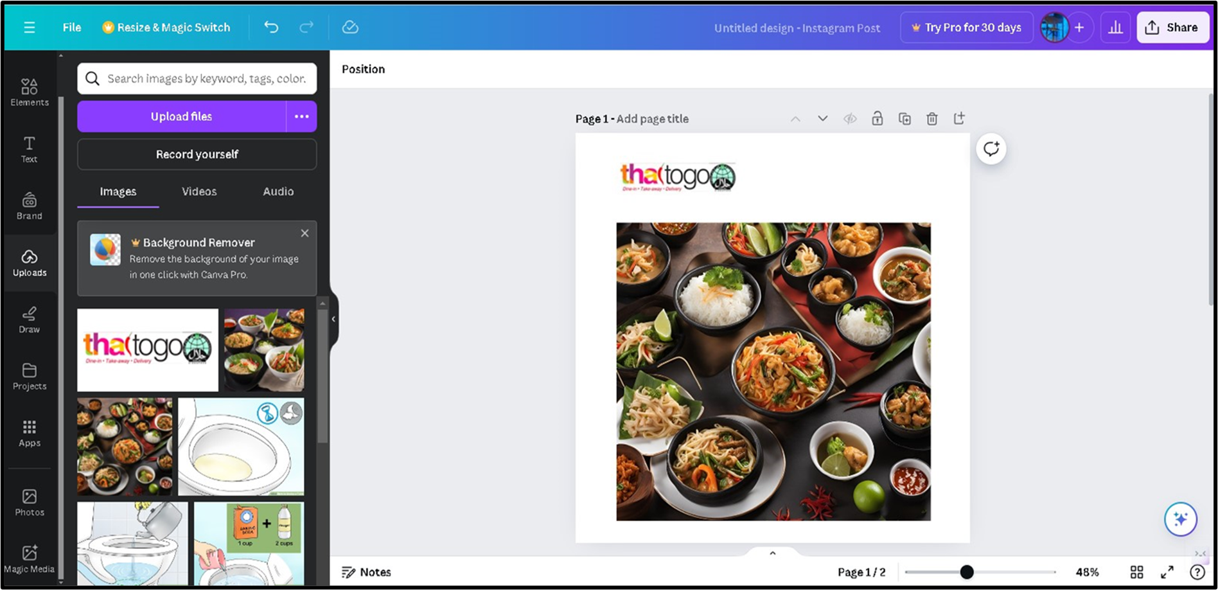

Slide 39
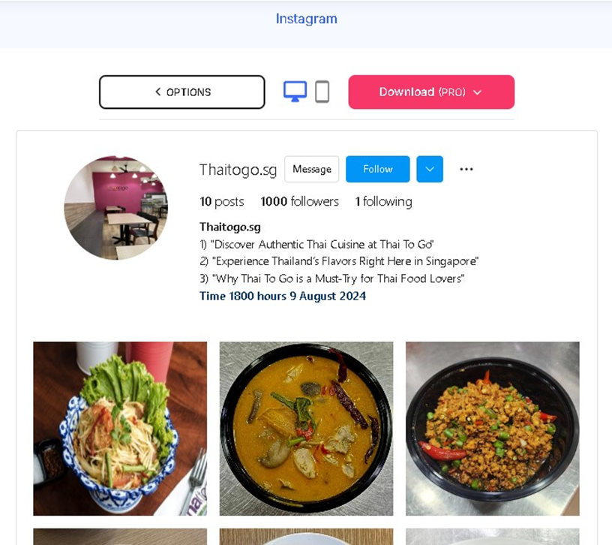
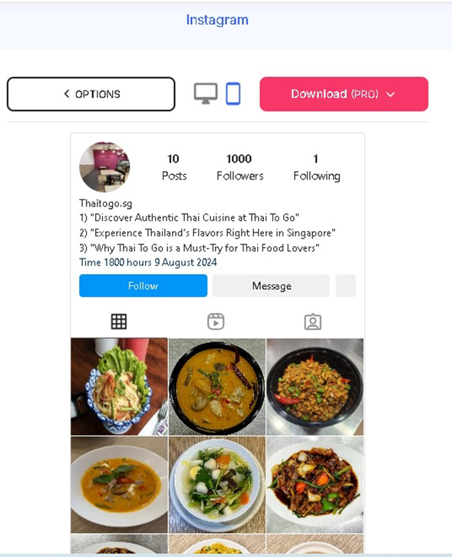
SOCIAL MEDIA MARKETING (AD) INSTAGRAM
Desktop
Mobile

Slide 40


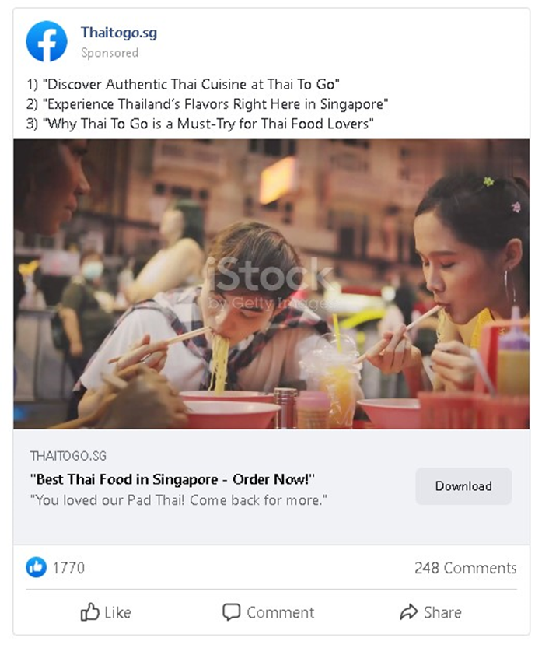
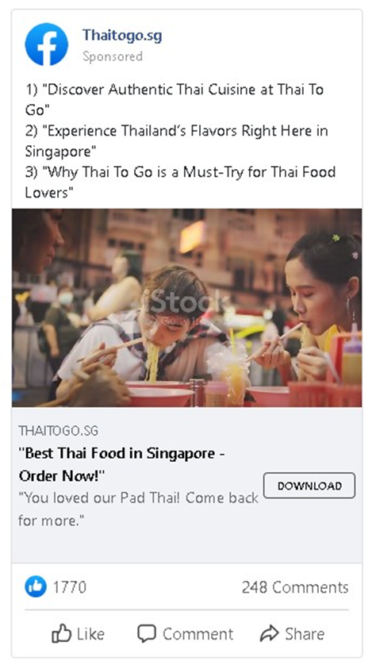
Social Media Posts (Ads) Face Book

Slide 41
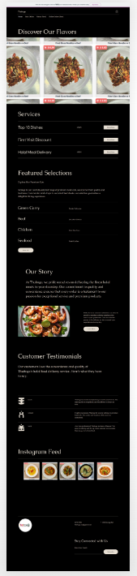
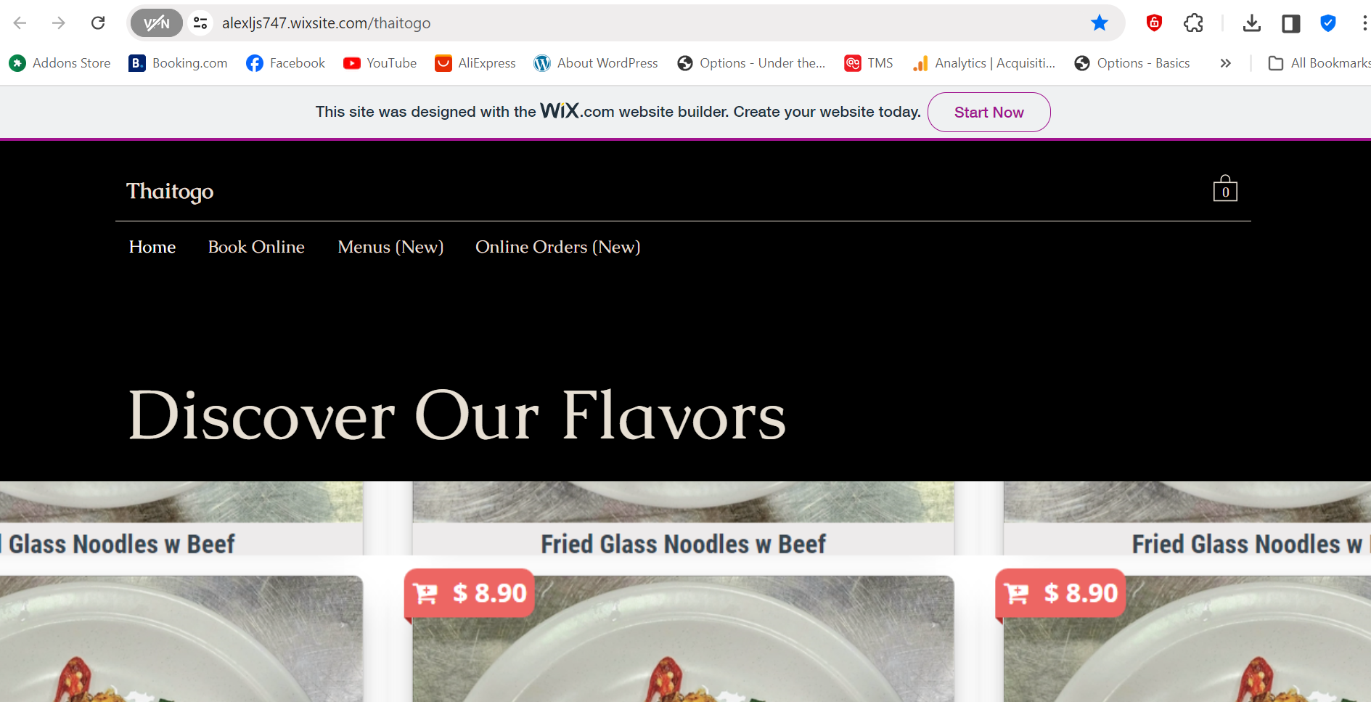
Landing Page-Desktop
https://alexljs747.wixsite.com/thaitogo

Slide 42
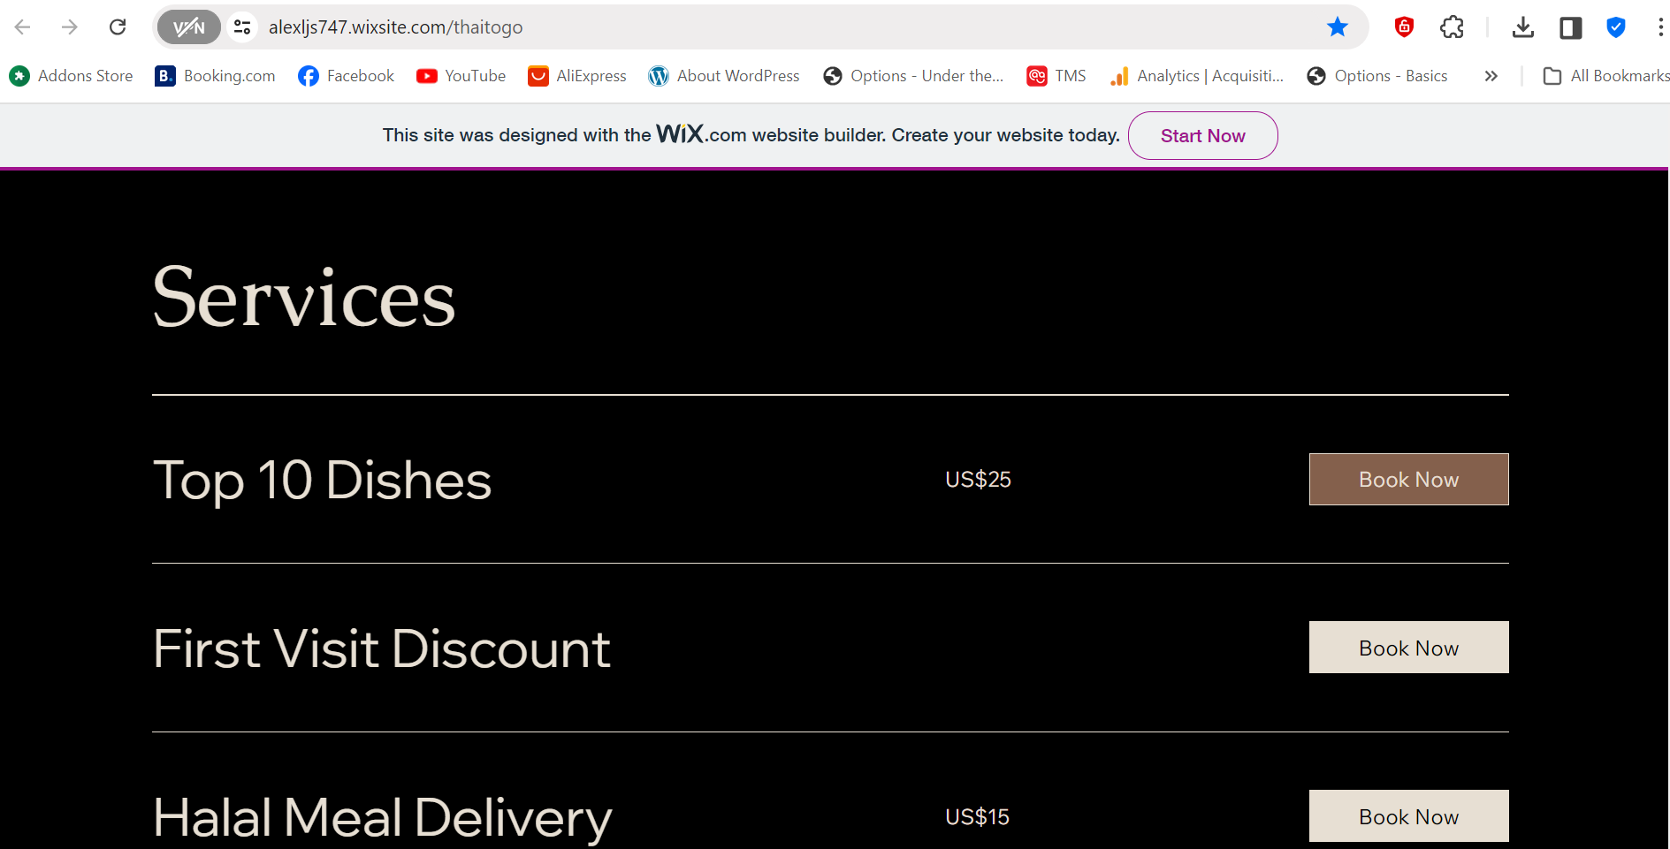
Landing Page-Desktop
https://alexljs747.wixsite.com/thaitogo

Slide 43
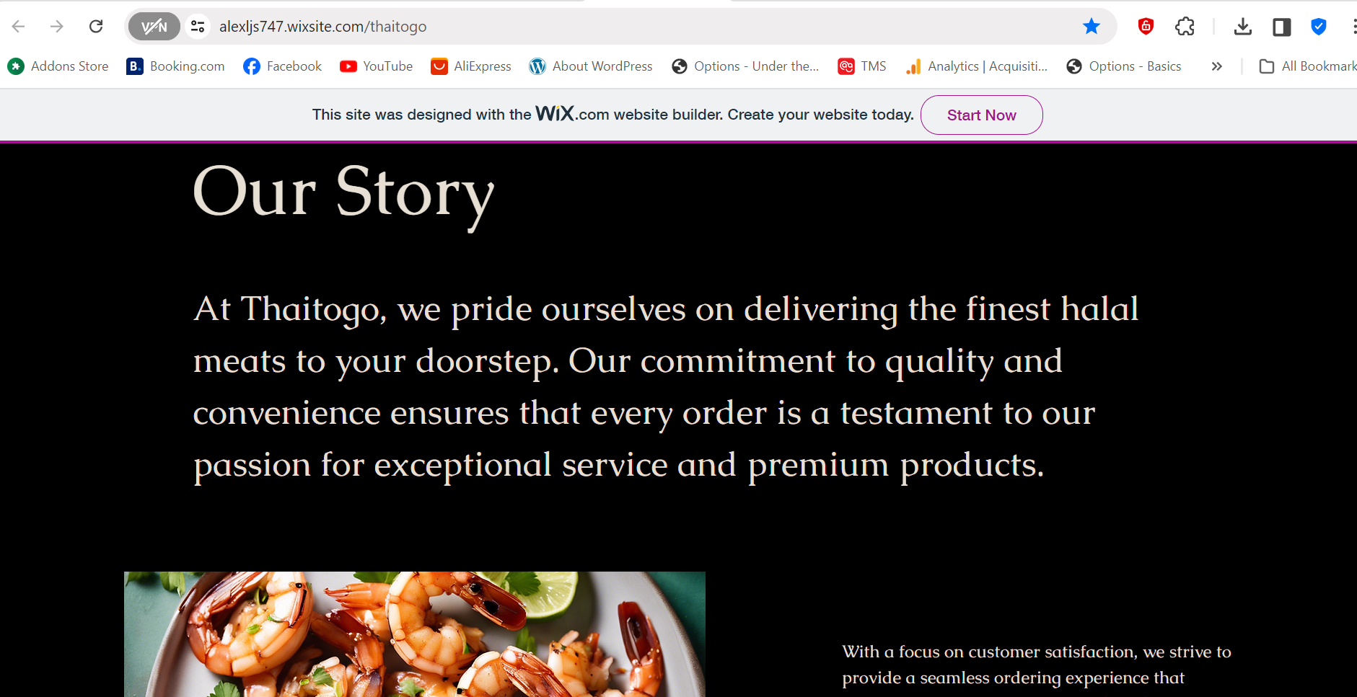
Landing Page-Desktop
https://alexljs747.wixsite.com/thaitogo

Slide 44
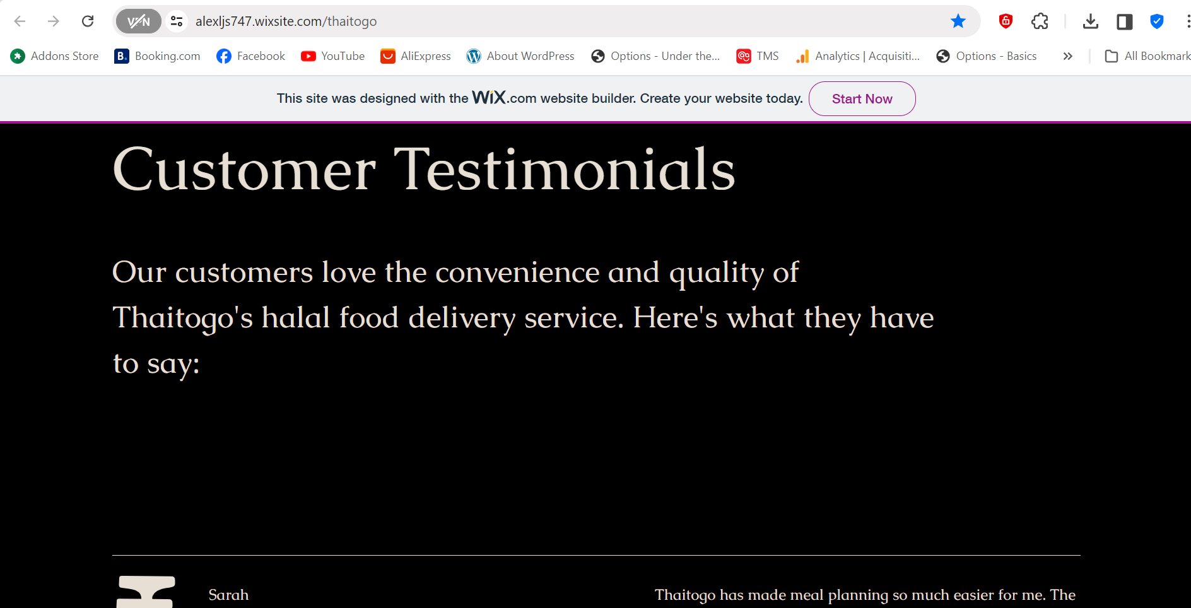
Landing Page-Desktop
https://alexljs747.wixsite.com/thaitogo

Slide 45
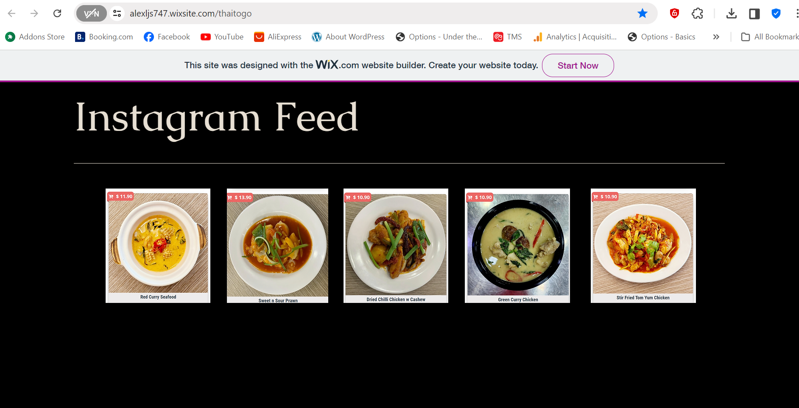
Landing Page-Desktop
https://alexljs747.wixsite.com/thaitogo

Slide 46
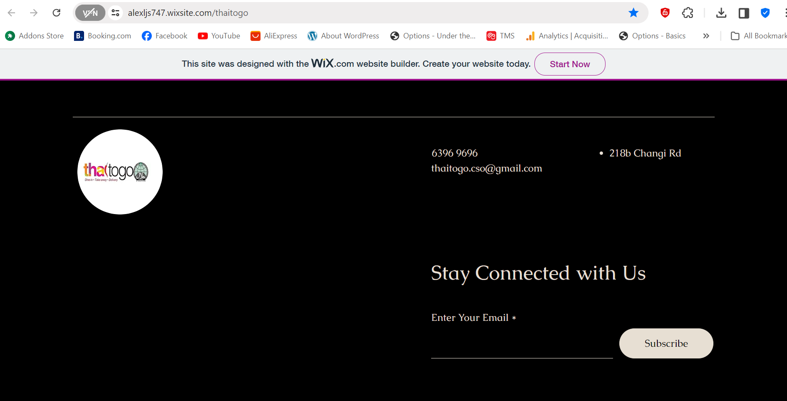
Landing Page-Desktop
https://alexljs747.wixsite.com/thaitogo

Slide 47
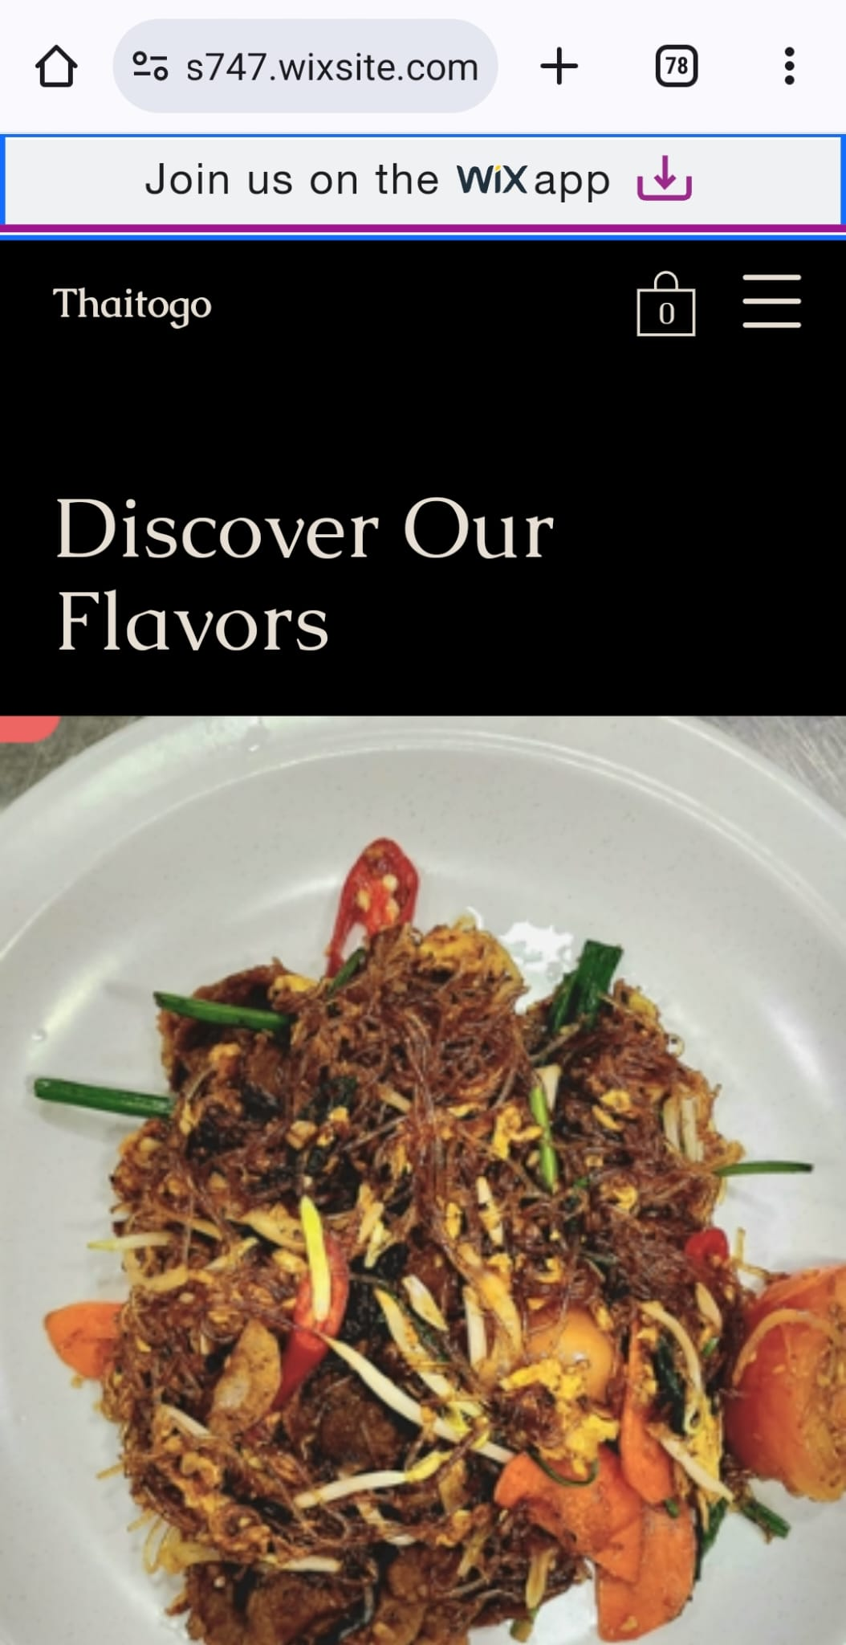
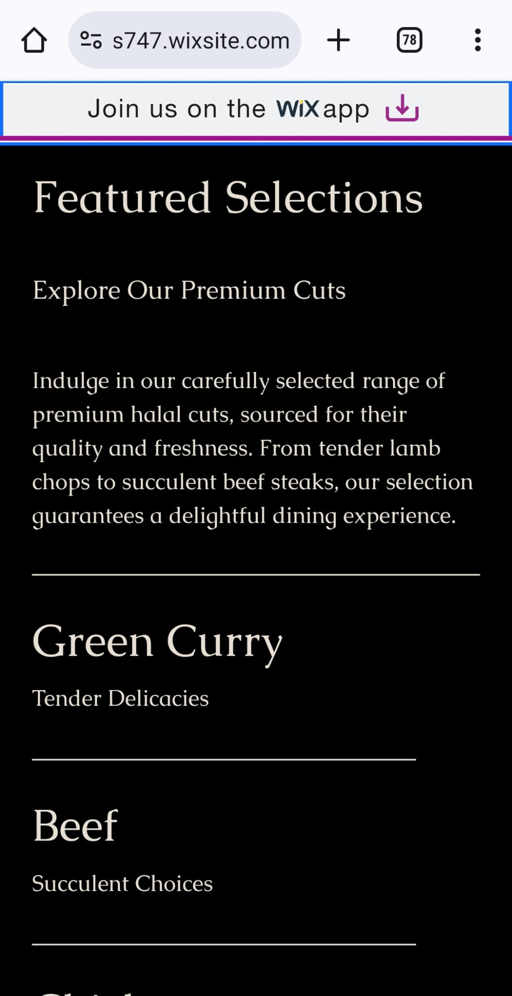
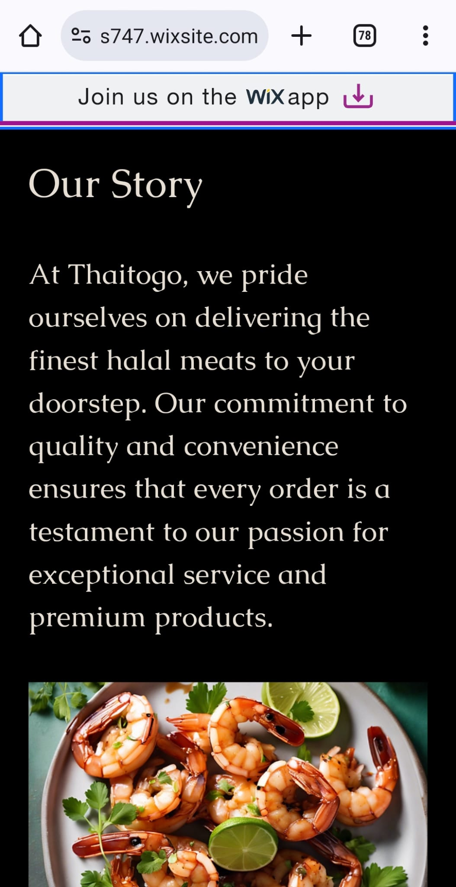
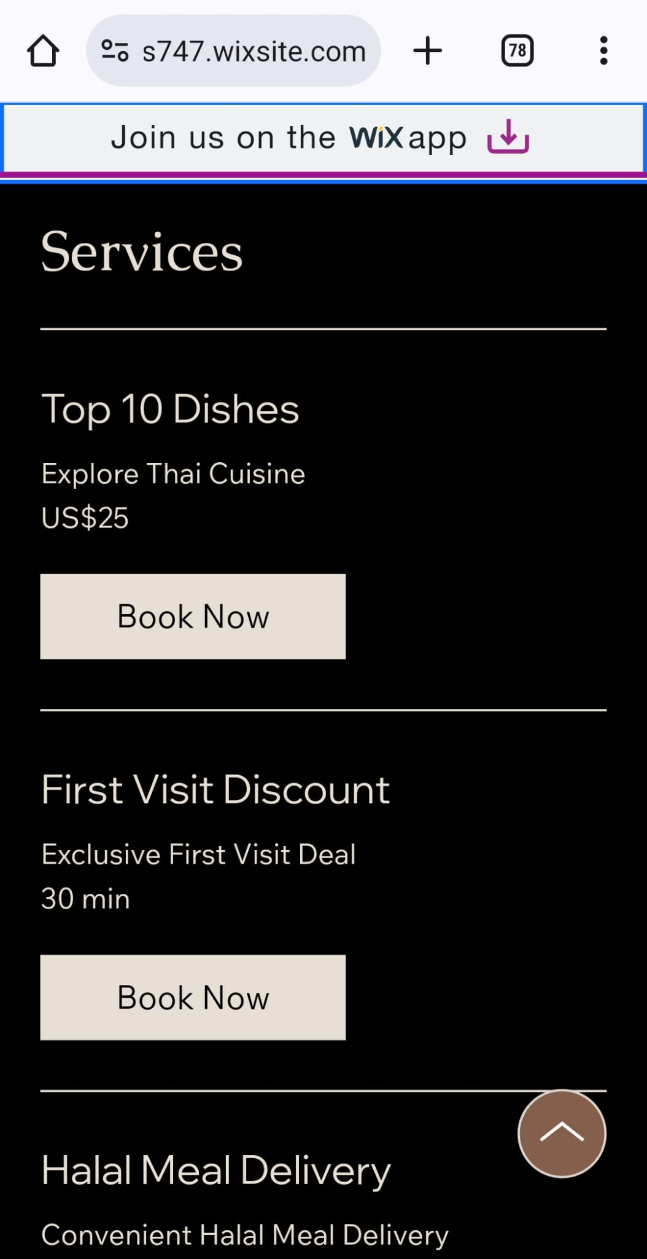
Landing Page OF Landing Page in Preview Mode for Mobile

Slide 48
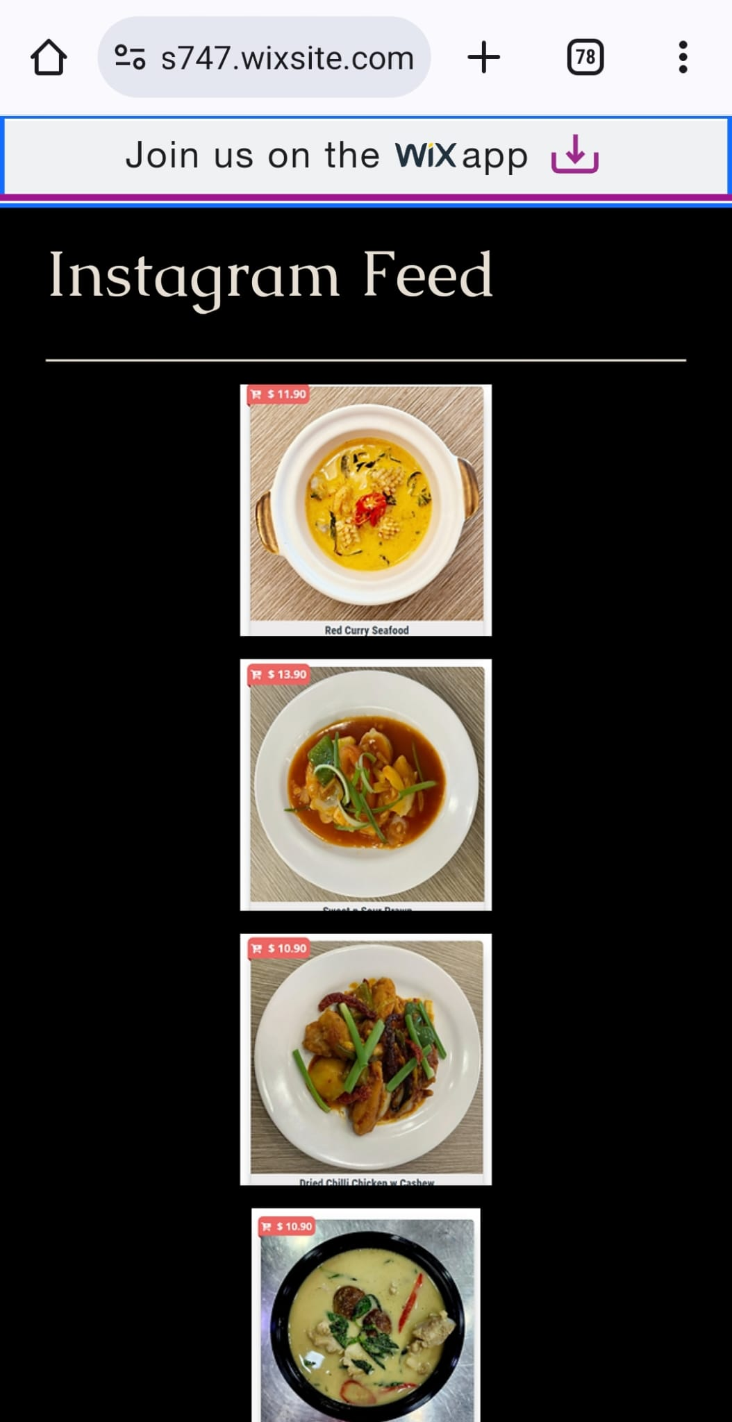
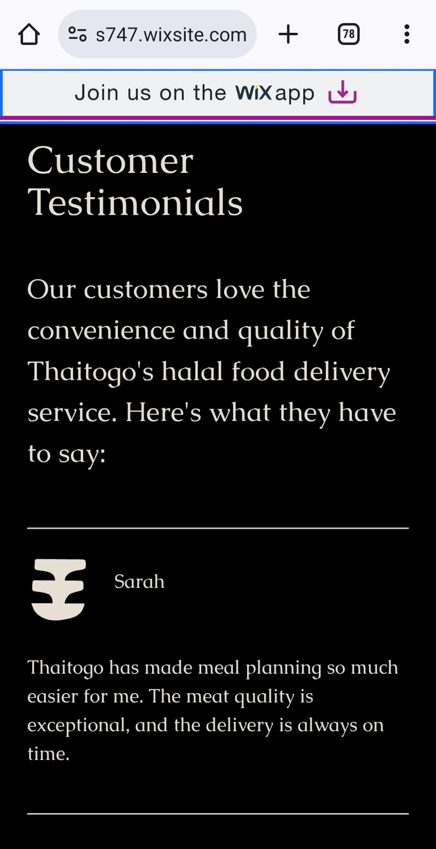
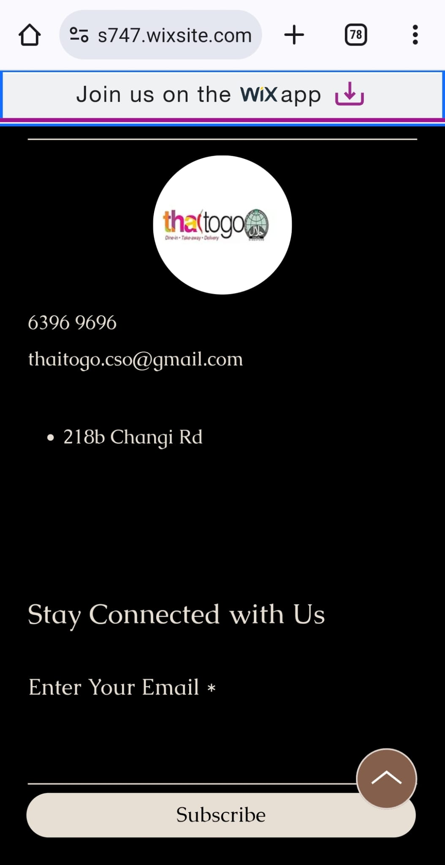
Landing Page OF Landing Page in Preview Mode for Mobile

Slide 49
Email Marketing
# | Content of email | Call To Action in Email
1 | Welcome to Thaitogo! Enjoy $5 off your first order. Introduce Thaitogo, highlight unique selling points (e.g., authentic Thai flavors, fast delivery), and provide an exclusive discount code. | Explore Our Menu, Sign Up for Newsletter
2 | Craving something spicy? Try our new Red Curry! Showcase a specific dish, include mouthwatering images, and provide a brief description of the ingredients and flavors. | Order Now, Learn More
3 | Our customers love us! Give positive customer reviews and testimonials to get free delivery. | Share Your Experience. Get free delivery

Slide 50
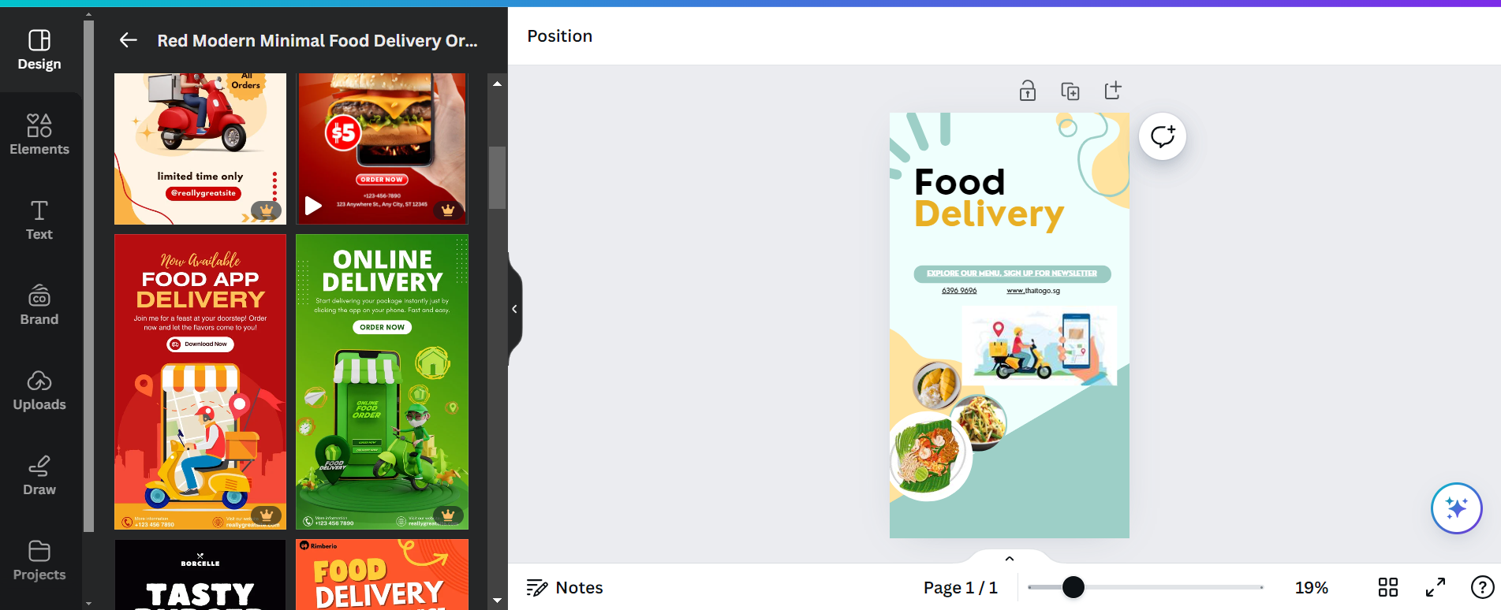
Email Marketing

Slide 51
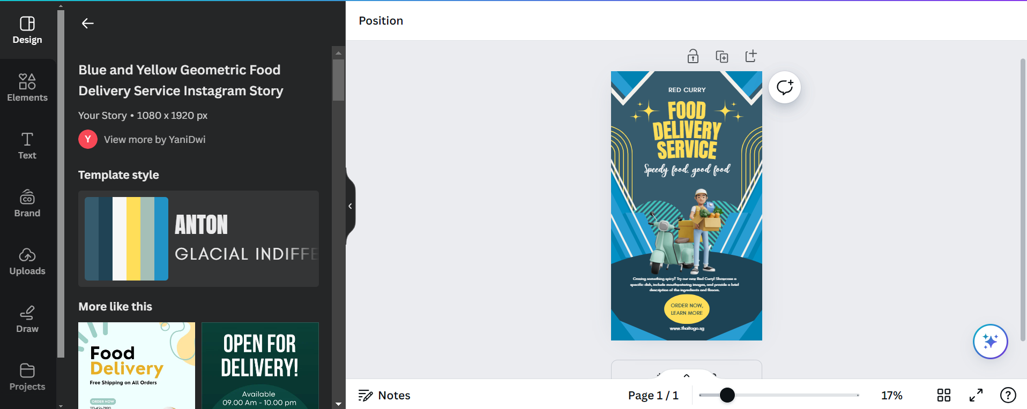
Email Marketing

Slide 52
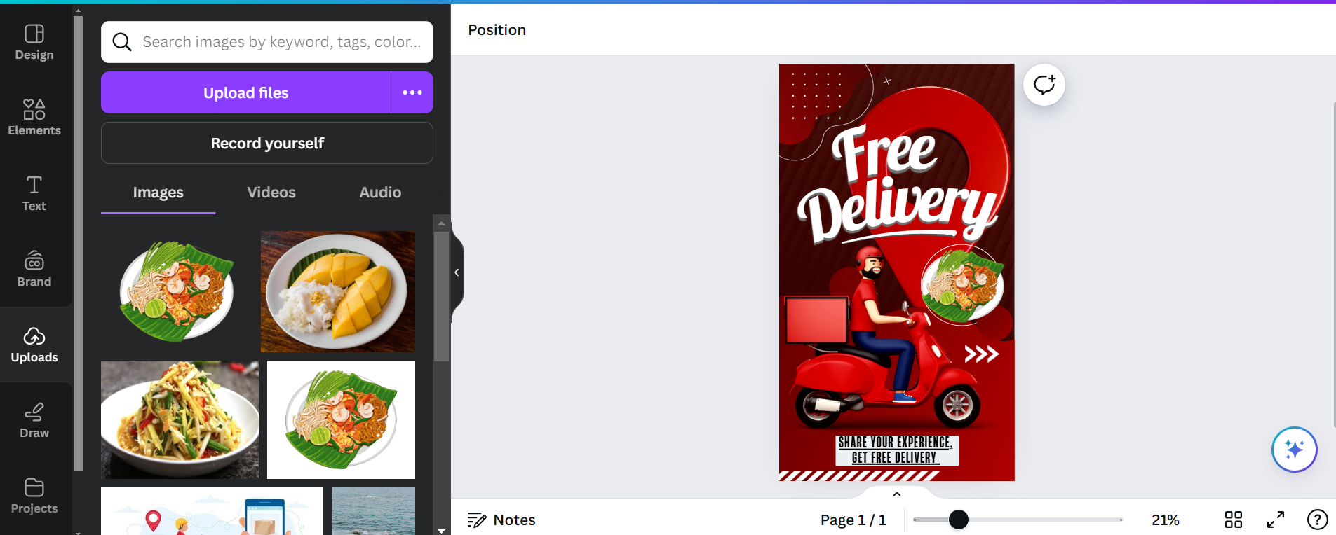
Email Marketing

Slide 53
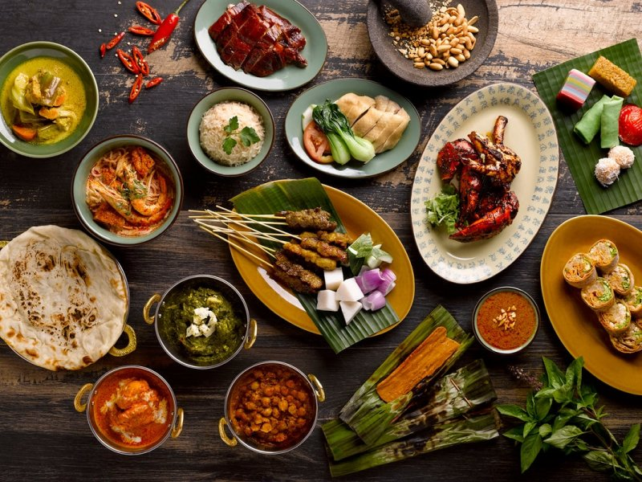
THE END OF THE PRESENTATION AND
APPRECIATE YOUR VIEWINGS
THANK YOU

